Slide 1

Network Protocol Troubleshooting Assistant
Westin Breger, Andy Holdener, and Stephen Jarnagin
POWER Engineers Contact: Keith Gray

Slide 2
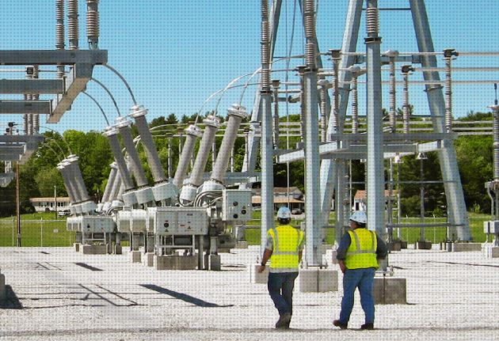
Power Engineers is a consulting firm
Founded in 1976
Advises and implements designs in foods, facilities, communications, environmental, and federal markets
Focuses on power system and electrical engineering in particular
www.powereng.com
Introduction

Slide 3
Power Engineers connects multiple Devices for its clients
Both devices are activated and checked for functionality
A connection is established between the devices
A standard network protocol is used
Synchronization between the devices begins
Once complete, the client’s predefined power regulations can be implemented
Introduction
Notes:
Make sure to go into why the one bullet point is underlined so that people don’t think it’s just randomly underlined.

Slide 4
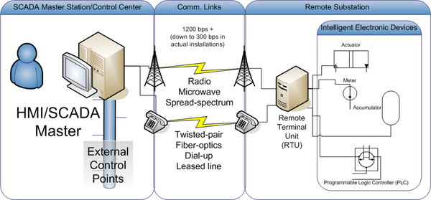
Power Engineers uses special networks for their electrical devices
Both protocols see widespread use by utilities industries.
Both are consistently updated and provide a wide support for devices.
en.wikipedia.org
Introduction
Notes:
Either move after DNP3 & Modbus slides or define it here.

Slide 5
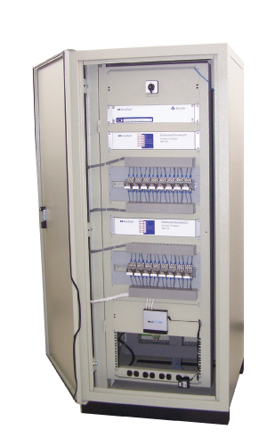

DNP3 is a Network Protocol
DNP3 (Distributed Network Protocol version 3) is a set of communications protocols used between components in process automation systems
Mainly used is in utilities such as electric and water companies.
It was developed for communications between various types of data acquisition and control equipment., in response to Modbus limitations.
www.novatechweb.com
Introduction
Notes:
Stefik didn’t complain, but should we really include a picture of a device that used the protocol? You can’t tell in any way, shape, or form that it uses DNP, lots of devices use DNP, and in the next slide we don’t have a picture of a slide that uses Modbus.

Slide 6

Modbus is another common network protocol
Modbus is a serial communications protocol originally published by Modicon in 1979 for use with its programmable logic controllers (PLCs).
The main reasons for the use of Modbus in the industrial environment are:
It has been developed with industrial applications in mind
It is openly published and royalty-free
It is easier to parse messages compared to DNP3
It moves raw bits or words without placing many restrictions on vendors
Introduction
Notes:
If we say easier to pare, then show an example of Modbus vs DNP3 instead of Modbus logo.

Slide 7
Manually translating network messages takes time
When devices are being synced, errors can occur and are sent out over the network using standard network protocols such as DNP3 and Modbus
To figure out what errors are occurring, the error messages must be intercepted and then decoded using a parsing method and data tables that correspond to the protocol that the messages were written in
This issue can be much larger when multiple errors occur between multiple devices and it can cause the engineer to take a significant amount of time to solve. This is worsened when the error is systemic between multiple devices
The Problem
Notes:
Removed:
The solution to these errors is to intercept the error message and look up the meaning of that message using a table.
This on average takes approx. ten minutes.

Slide 8
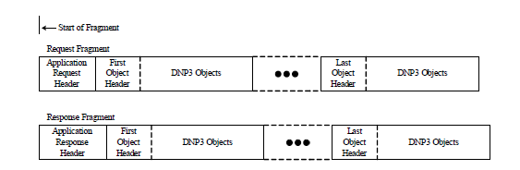
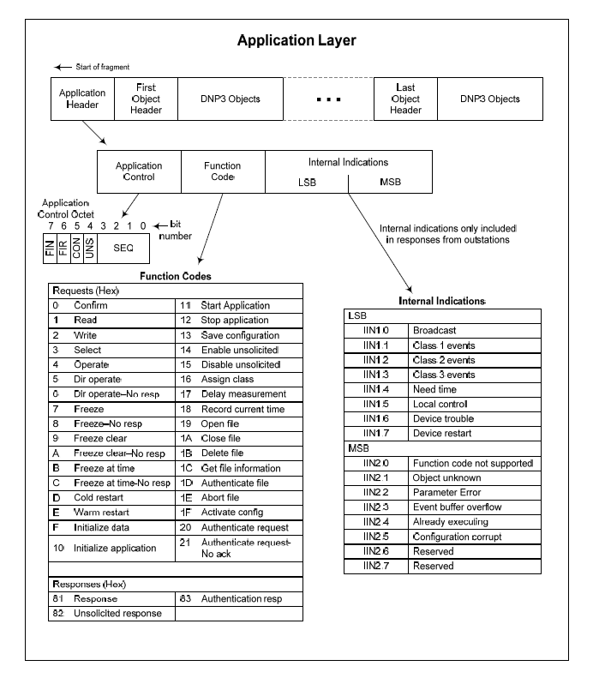
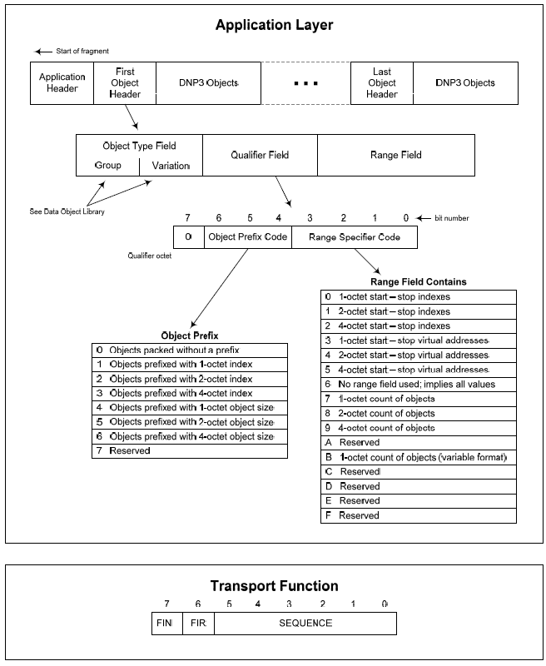
It may be necessary To translate MESSAGES by hand
From DNP3 Protocol documentation
05 64 05 C0 01 00 0A 00
The Problem
Notes:
Cite images all over.

Slide 9
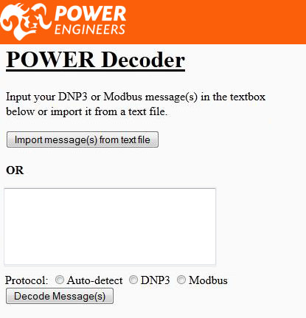
Our product interprets, translates, and displays network protocol content
It will allow a wider range of users to decode messages written in either protocol
It automates the message translation
It automatically determines which protocol the messages are written in
Requirements
Notes:
I like the intention of this slide (to introduce our product) but I think it needs a serious revamping, or possibly all new text.

Slide 10
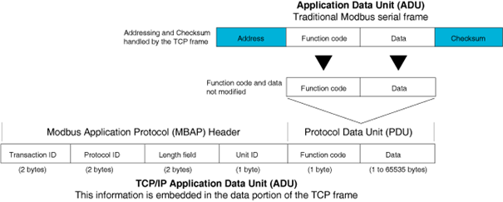
Capable of translating DNP3 and modbus
Able to read and identify the ‘fragments’ between the various layers of the DNP3 and Modbus.
Will determine the kind of command that is being issued, the circumstances of the message, and the data within.
This is accomplished by using algorithms to parse and translate the code into a format that can be later used for a solutions table.
motion.schneider-electric.com
Requirements
Notes:
Think about combining with next slide since we’ve already gone over protocols.

Slide 11
Our interface assists users in inputting data and reading the resulting output
Users can input their messages in various ways
User can view the specific details of their input in a plain textbox before decoding it
The decoded message is organized in a tree-view in order to save space
Requirements
Notes:
Orange background for prototype is really bad.

Slide 12
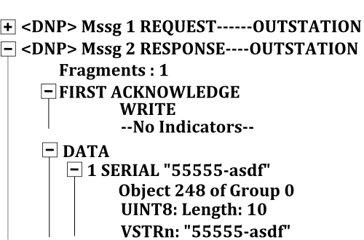
Displays A specific representation of the messages
Displays a list of all messages found in the user’s input
Each message will be expandable to reveal its specific details
Saves real-estate by not showing all messages’ details at once
Requirements
Notes:
Removed: Depending on that depth of the message, the expansion could be longer than one expansion.

Slide 13





Non-functional requirements
Python 3.3 is the programming language we are using to perform the computations necessary to decode the error messages
Django 1.5 is the platform we are using to run the graphical interface of our application because it supports our core Python code
Will also use Javascript 1.8.5 and HTML5
Application will be able to run on IE8, IE9, Firefox(v.20), and Chrome(v.25)
Pip 1.3.1(Pip Installs Packages) will be used to install our application onto users’ computers
Uses the GPL licensing agreement v.3, making the technology open to all
Hosted on GitHub
Requirements
Notes:
Removed bad title and replaced it with super-generic, but somehow acceptable title.

Slide 14
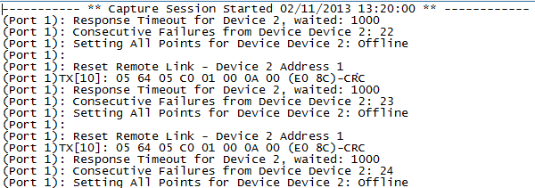
The Decoder will run Against 30 unit tests
Tests are captures of transmission logs provided by customer
Will use PyUnit to test all sample cases
15 unit tests will be run for each network protocol
Requirements
Notes:
Collection of = bad, Use specific number. Bad last bullet point.

Slide 15
Team Process
We first split our goal into two categories:
Interface
Decoder
We divided up into teams to complete tasks most fitted to the team members, and switch up as needed.
We had bi-weekly meetings with our client to ensure that we were on the right track.
Refined process and design through an iterative process based on feedback
Once per month, or as needed, we bring together the two team’s work together
Goals

Slide 16
 | 1st Semester Milestones | Date Completed | Completion Status
1 | Read, understand, and be able to parse Distributed Network Protocol v.3 | 3/25/2013 | pending
2 | Read, understand, and be able to parse Modbus | 9/25/2013 | pending
3 | Create low fidelity prototype of the parser that parses DNP3 | 4/12/2013 | complete
4 | Successfully run parser against first test cases | 4/15/2013 | complete
5 | Create low fidelity prototype of the interface | 4/12/2013 | complete
6 | Read, understand, and be able to implement environments using Django 1.5 | 3/25/2013 | pending
7 | Develop low fidelity prototype of webpage using Django 1.5 | 4/12/2013 | complete
8 | Read, understand, and be able to implement Pip installer tool | 4/20/2013 | pending
9 | Integrate low fidelity parser and interface | 4/25/2013 | pending
10 | Deploy integrated low fidelity prototype using Pip | 4/26/2013 | pending
Goals
Notes:
Added requirements number

Slide 17
 | 2nd Semester Milestones | Date Completed | Completion Status
11 | Expand low fidelity parser to include more complex messages for DNP3 | 9/25/2013 | pending
12 | Test low fidelity parser successfully against all test cases for DNP3 | 9/30/2013 | pending
13 | Include the ability to parse Modbus for the parser | 10/10/2013 | pending
14 | Test low fidelity parser successfully against all test cases for Modbus | 10/15/2013 | pending
15 | Link the parser to the website and have it successfully operate | 10/30/2013 | pending
16 | Develop all functionality for the website | 11/10/2013 | pending
17 | Develop high fidelity prototype of the website using Django 1.5 | 11/20/2013 | pending
18 | Develop and inspect server specifications for the client | 11/30/2013 | pending
19 | Deploy using Pip and or deploy on the client’s server | 12/4/2013 | pending
Goals

Slide 18
Questions?
Goals

Slide 19
Thank you for your time
Goals

